Slide 1
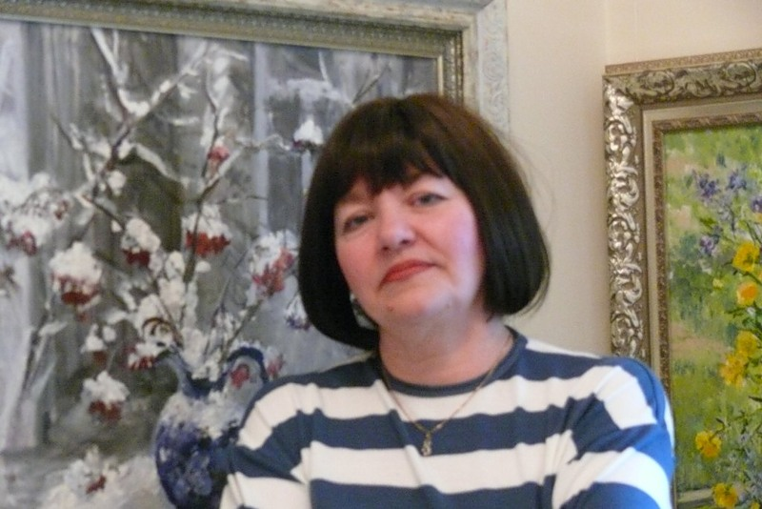
«In search of fog: Canterbury through the eyes of Olga Zolotova».

Slide 2
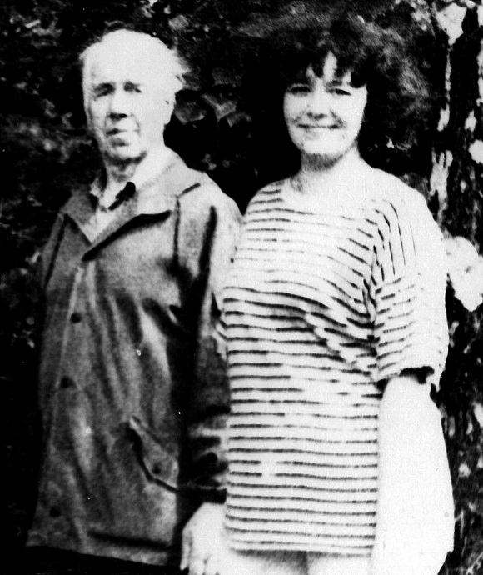
Olga was born in 1956 in Vladimir, and from an early age she tried to work with paints next to her father, a member of the Union of Artists of Russia Zolotov Evgeny Alexandrovich, went with him to etudes. She later studied painting with him. From 1970 to 1972, she studied at the Children's Art School (first graduation).
Olga Zolotova with her father, the artist Evgeny Alexandrovich Zolotov

Slide 3
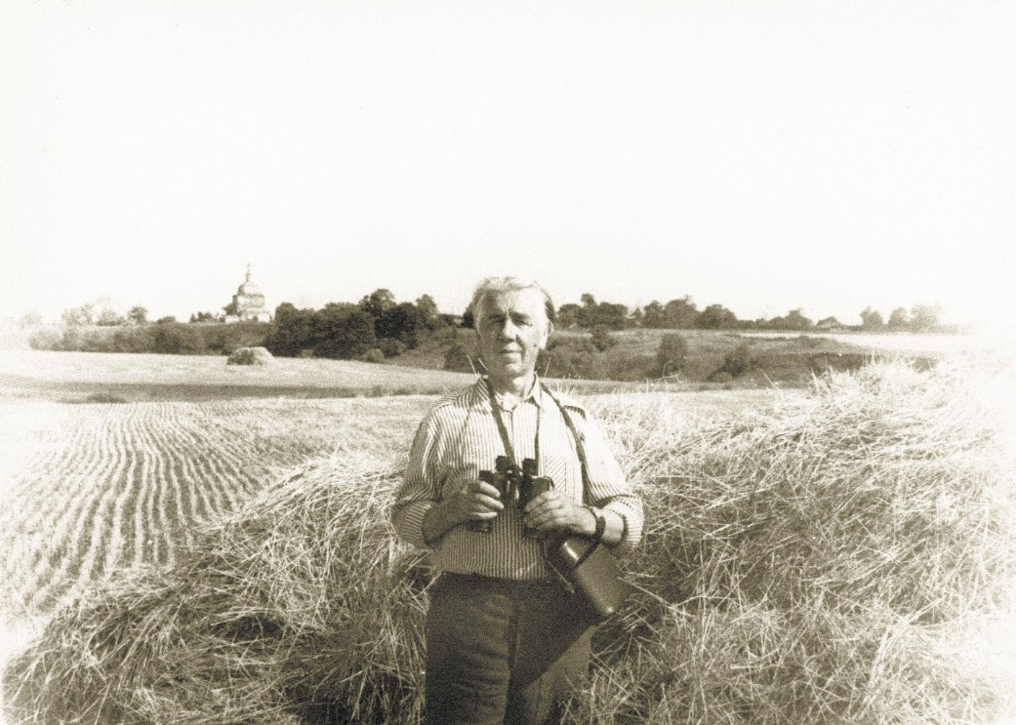
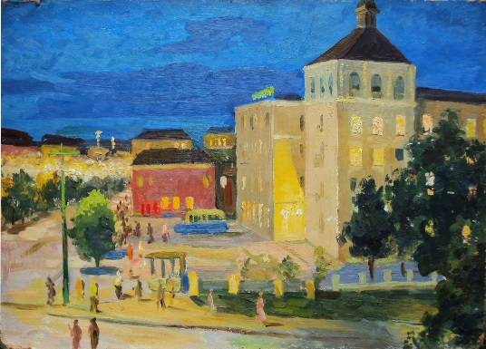
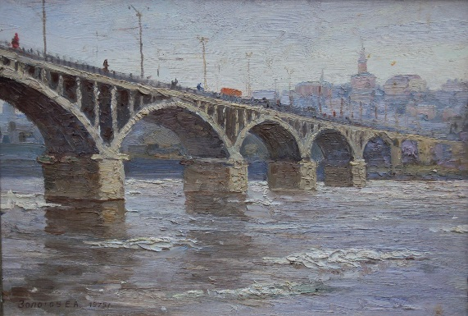
Zolotov E.A. "Night Vladimir" cardboard, oil 49,5X70 1976
Zolotov Evgeny Alexandrovich
Zolotov E.A. "Ice drift" cardboard, oil 33X48 1975

Slide 4
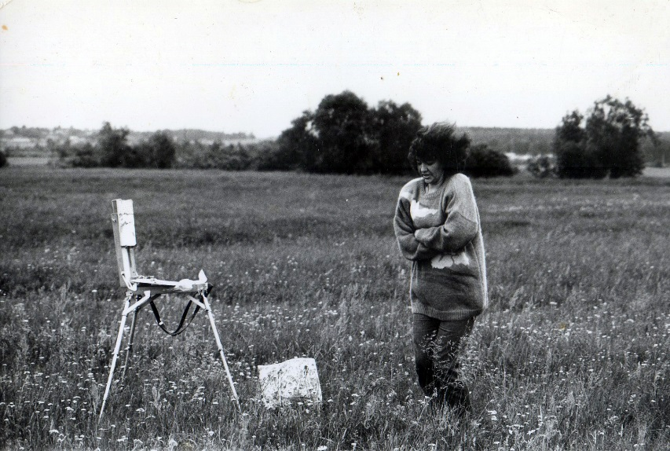
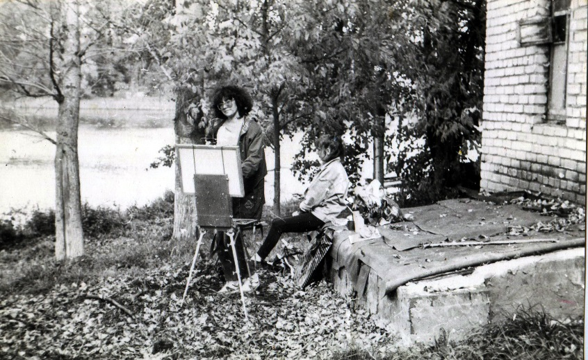
In 1973, she began working at the State Bank and entered the Financial and Economic Institute. She got a higher banking education and worked in banking structures until 1989. Then she decided to change her life and became a freelance artist in 1994.
«On the sketches. It's cold!!!» 1996
«Autumn sketches» 1995

Slide 5
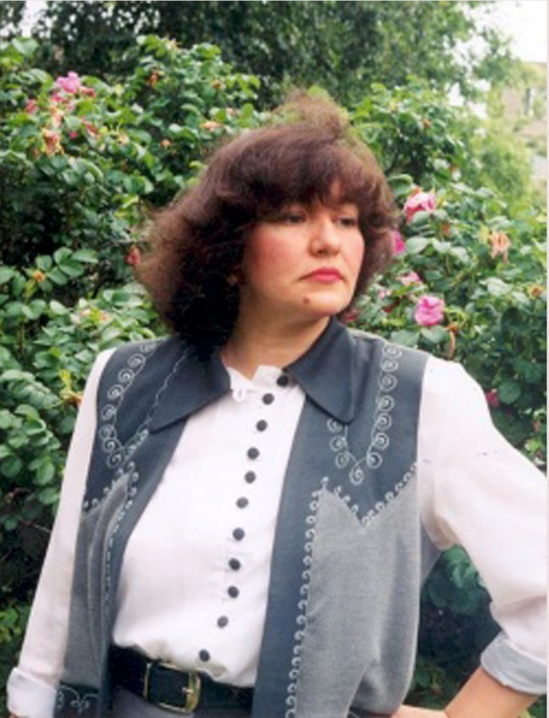
Her artist experience began in 1995, with her first participation in the regional exhibition. Since then, she has been a permanent resident of regional and zonal events. She often held personal vernissages. She was constantly improving her skills, studying the legacy of the old masters and the work of modern artists.

Slide 6
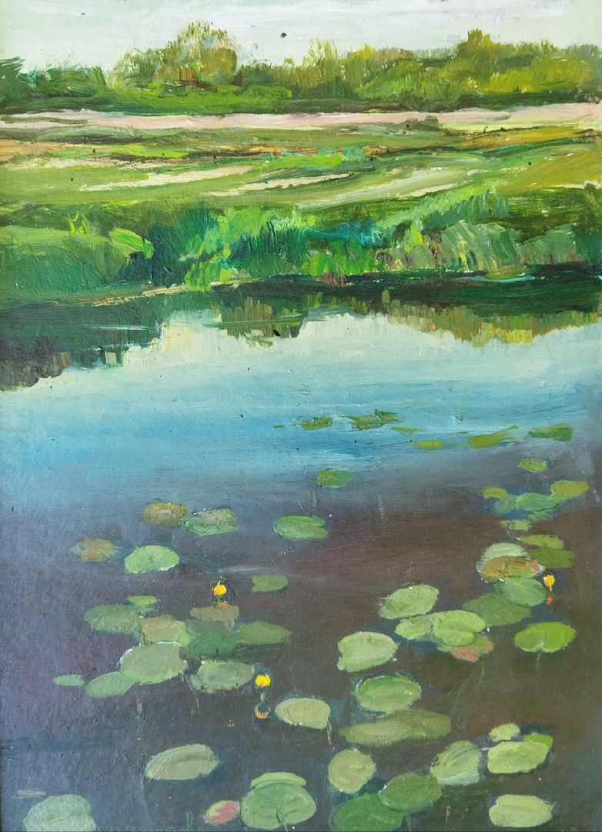
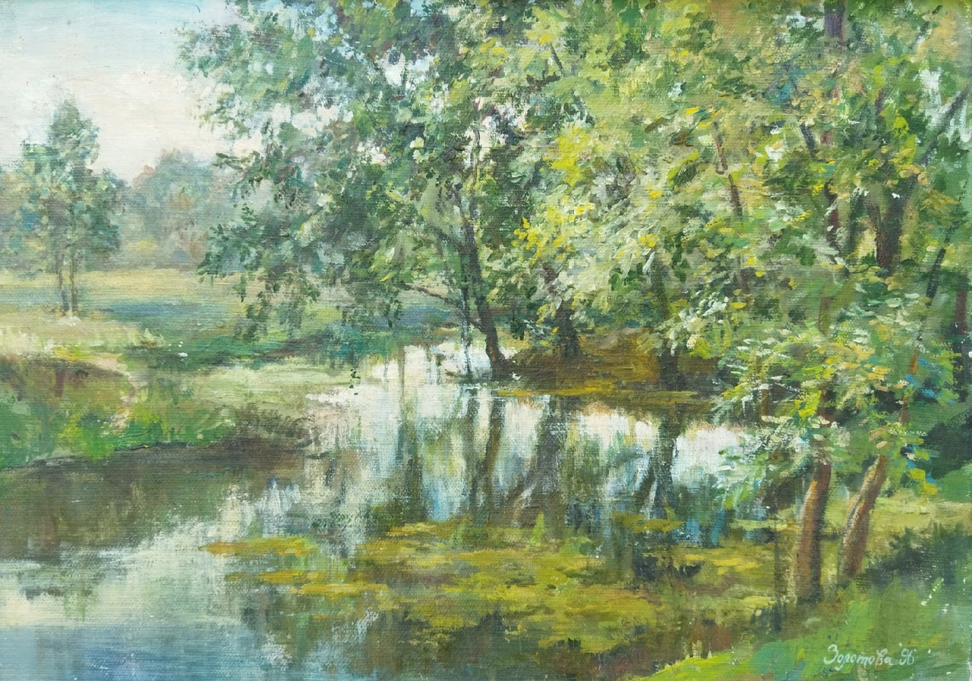
"Evening water lilies" cardboard, oil 25X35 1994
"Pond in Dobroe" canvas, cardboard, oil 35X50 1996

Slide 7
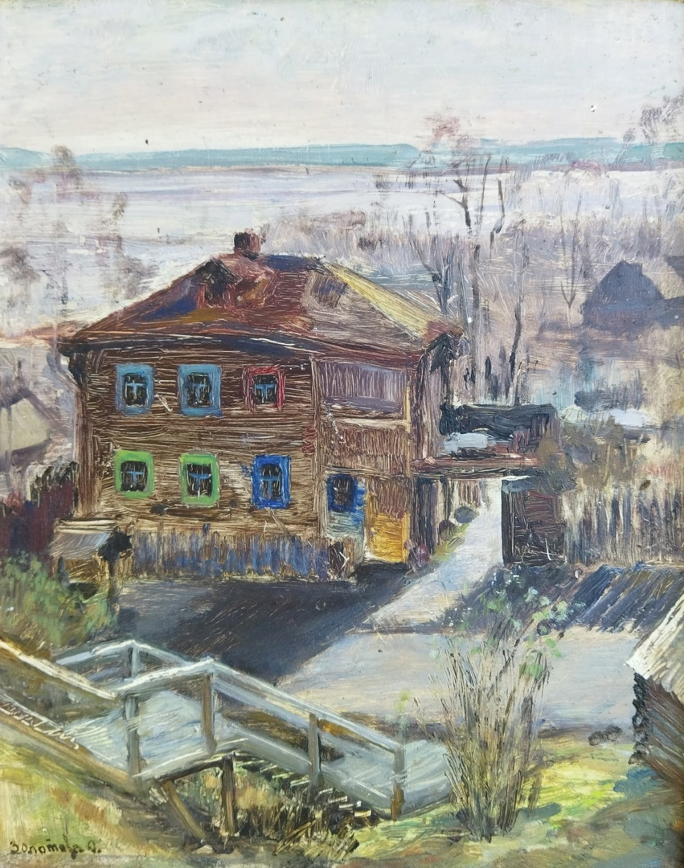
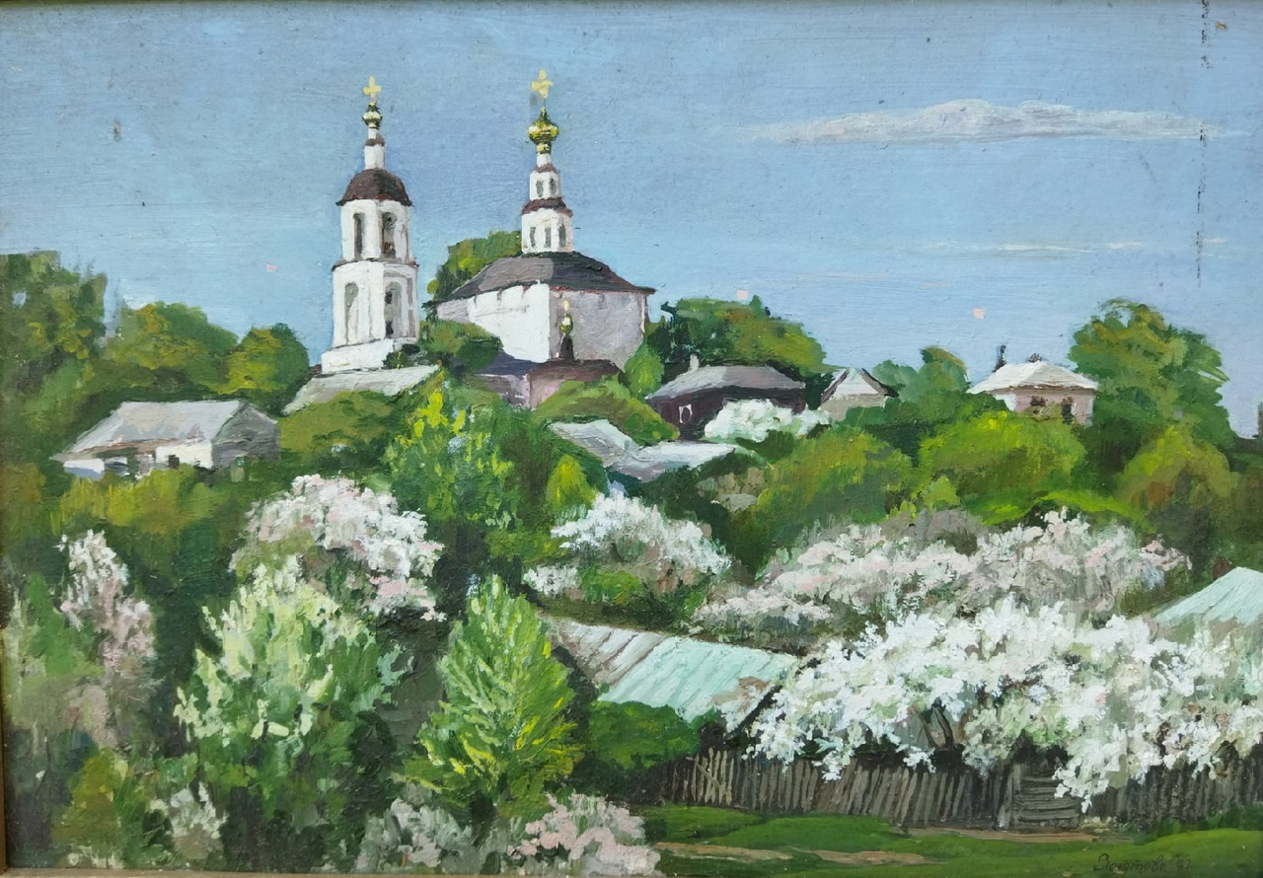
"Spring in the yard" cardboard, oil 25X31 1995
"Gardens are blooming" cardboard, oil 35X50 1994

Slide 8
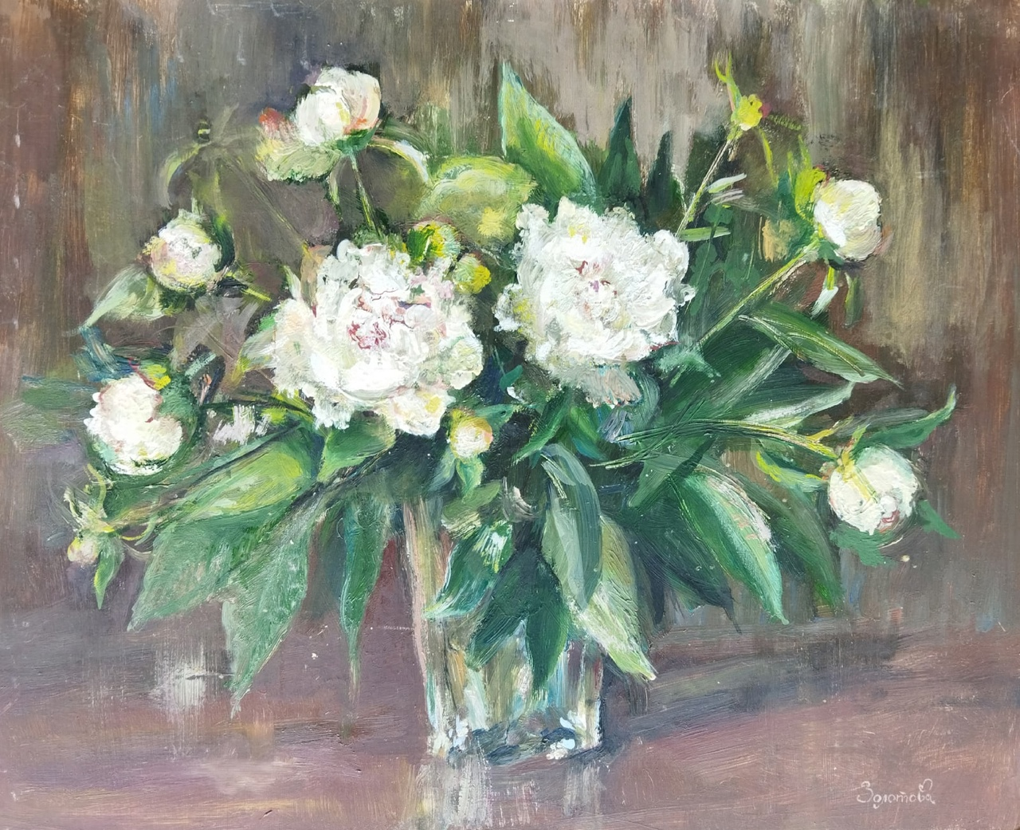
"Peonies" cardboard, oil 30X40 1999

Slide 9
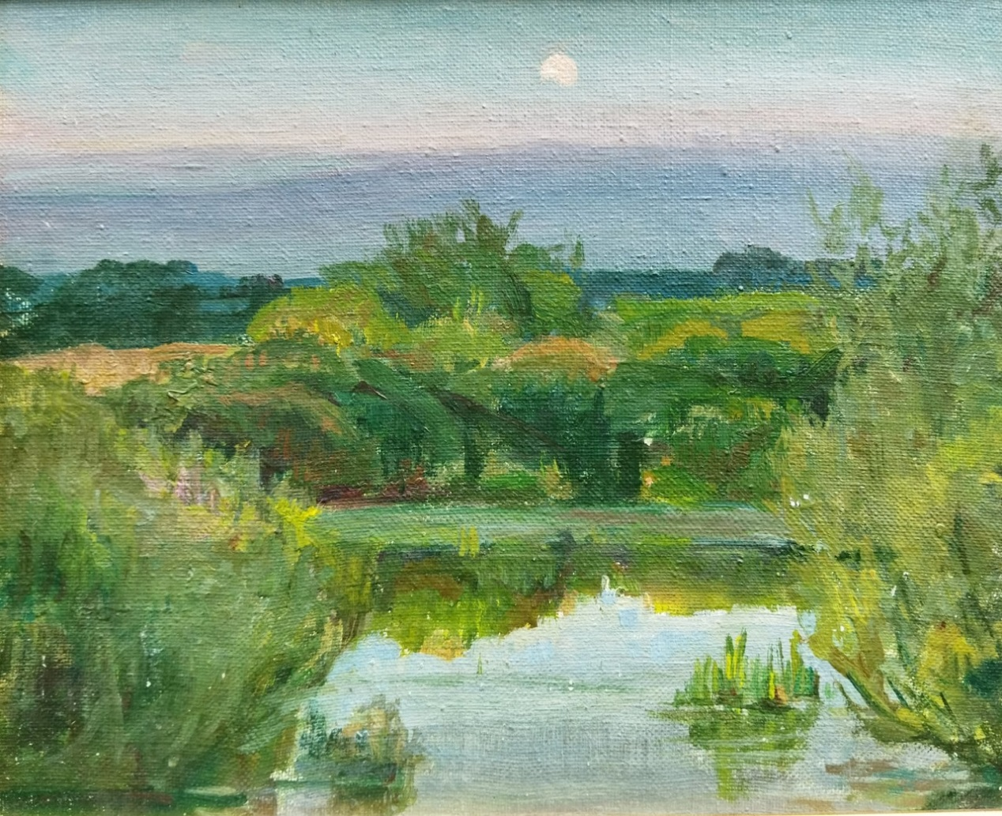
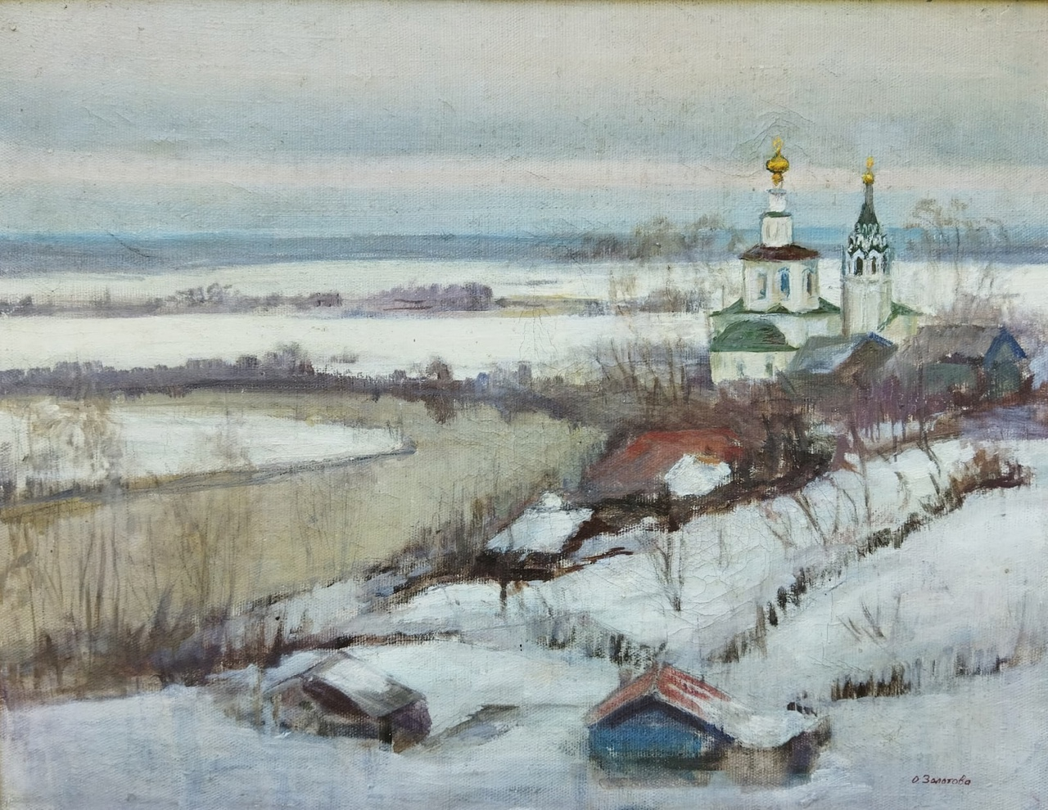
“Moon Elsa" canvas, cardboard, oil 35X43 1994
"April snow" oil on canvas 40X50 1995

Slide 10
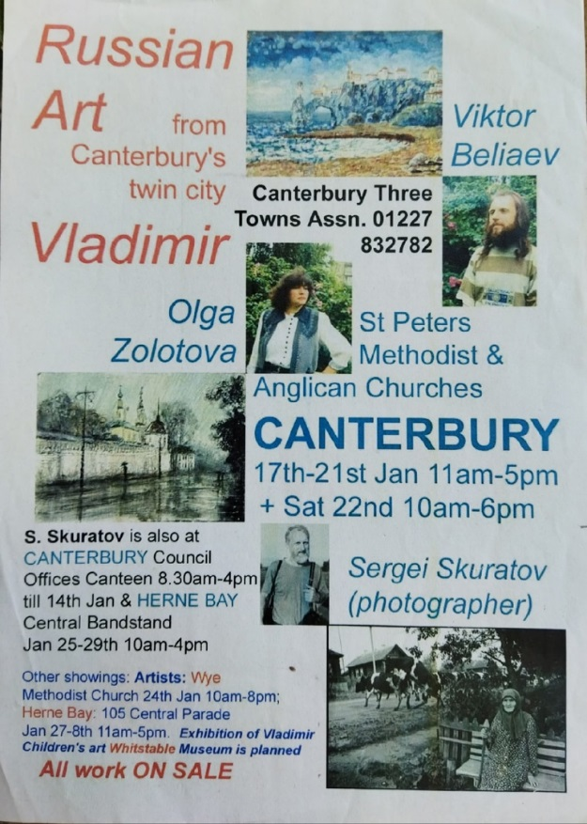
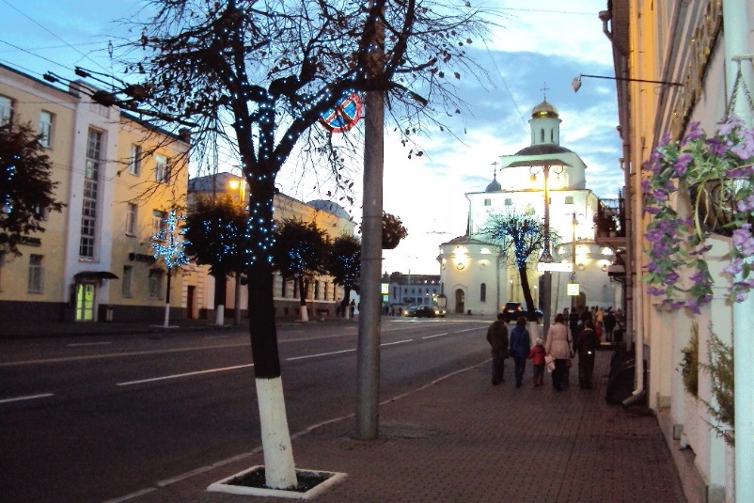
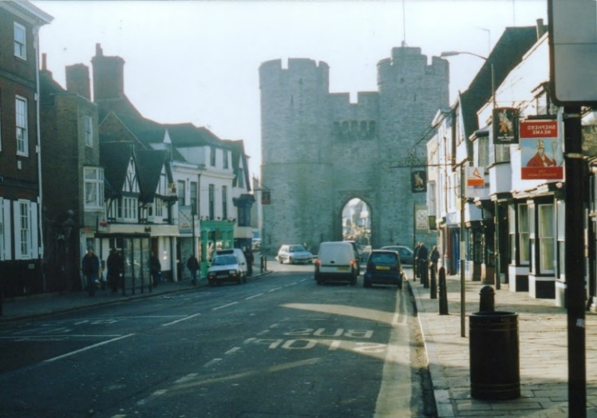
In 2005, with the support of the Vladimir Twin Cities Association (Vladimir-Canterbury–Bloomington-Normal) she visited the city of Canterbury with an exhibition of paintings.
We were waiting to meet the famous English fogs. We were convinced that British cities were covered with fogs, in which the prim inhabitants of Albion ate oatmeal in the morning and drank traditional tea at five o'clock.

Slide 11
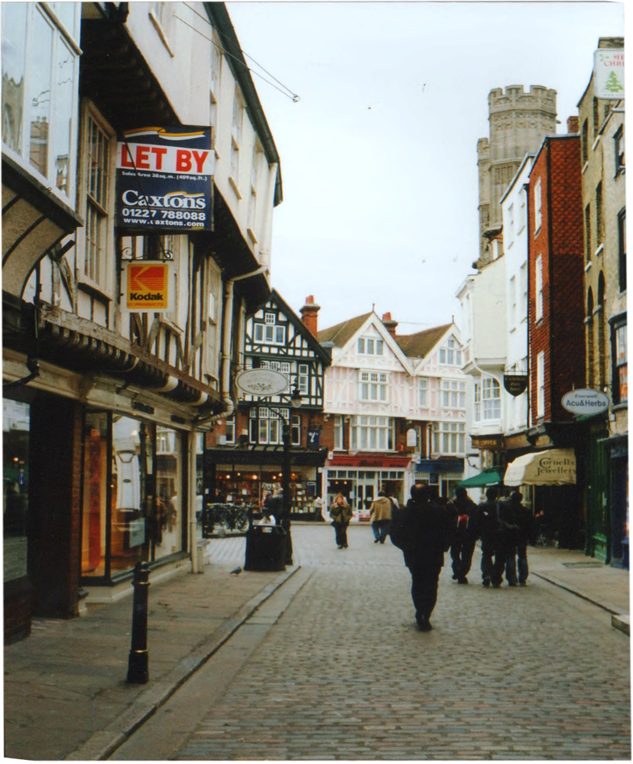
We found ourselves in a town lost in time. The houses were more original than each other, strung on the road like pearls on a thread, and the Cathedral rising into the abyss of the sky confidently counted off the next hundred years.

Slide 12
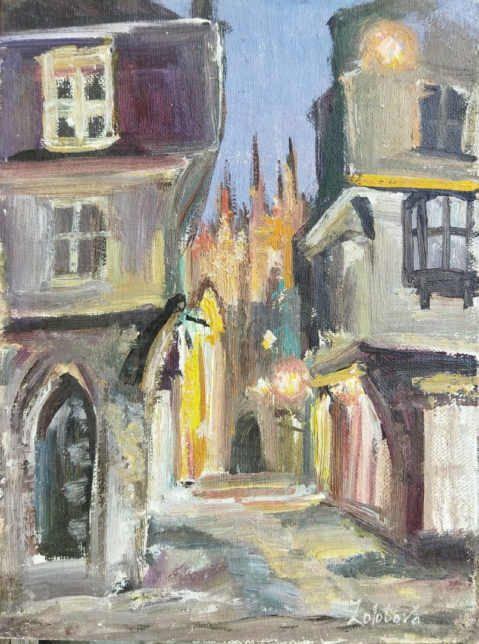
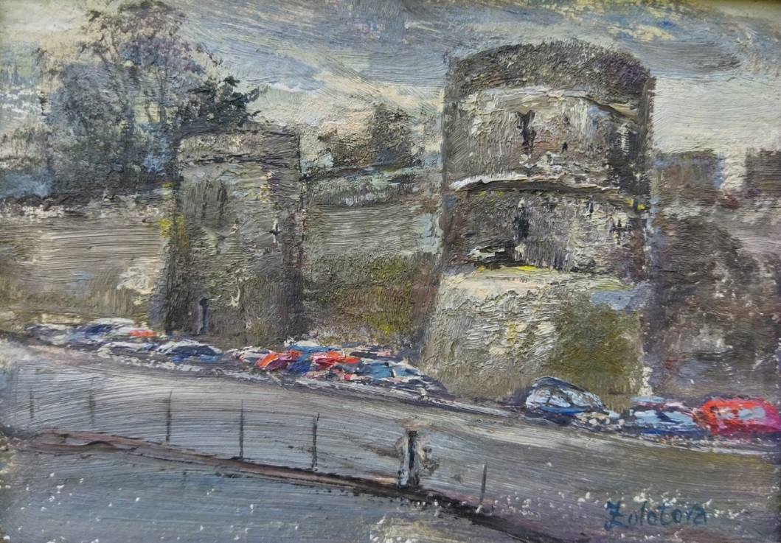
The next day was devoted to sightseeing in Canterbury: the Cathedral, the ancient Roman fort, the ruins of the XI century castle, the ancient Gates of the city.
"Night view from Canterbury Cathedral" canvas, cardboard, oil 19X25 2005
"Ancient Roman fort in Canterbury" cardboard, oil 13X18 2005

Slide 13
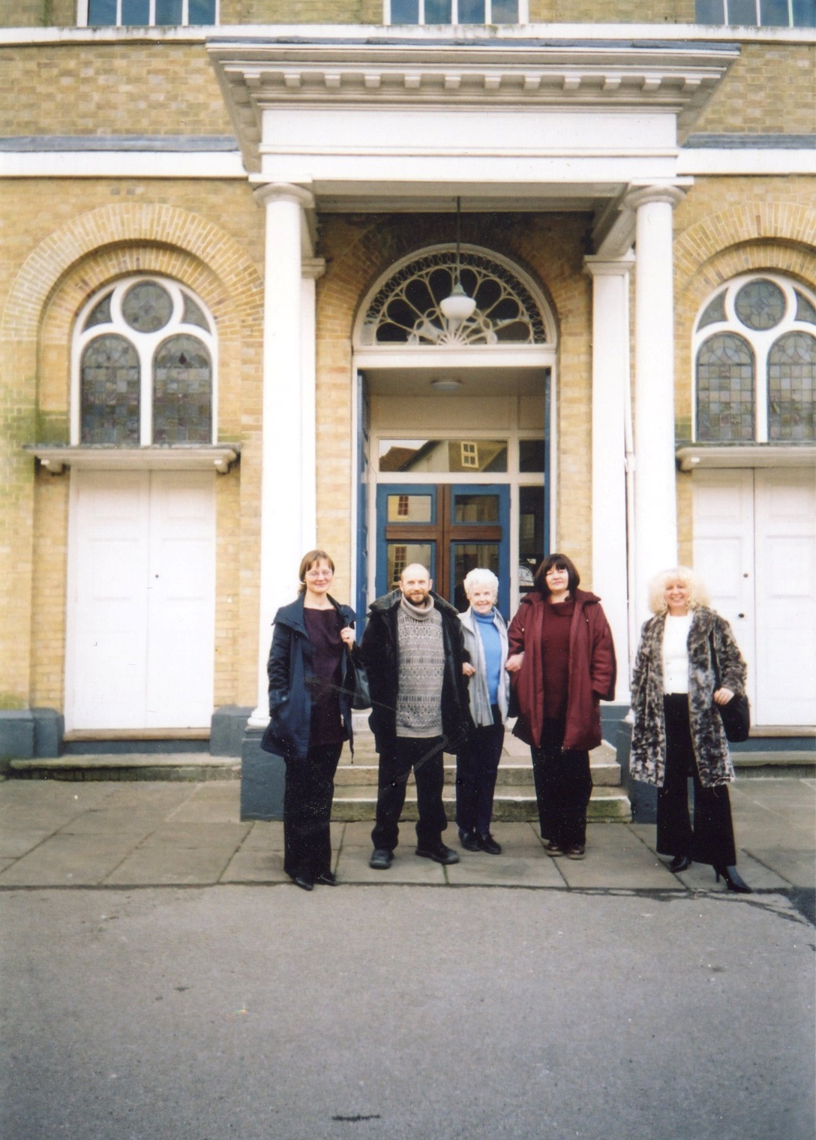
The seventeenth day of January was spent in the hassle of installing the exhibition. In a spacious, bright room that could be mistaken for a cultural center. But it turned out to be a Methodist and Anglican church. Visitors began to come already during the technical work, offered their help, and shared their emotions from watching. Simple, sweet, homely.

Slide 14
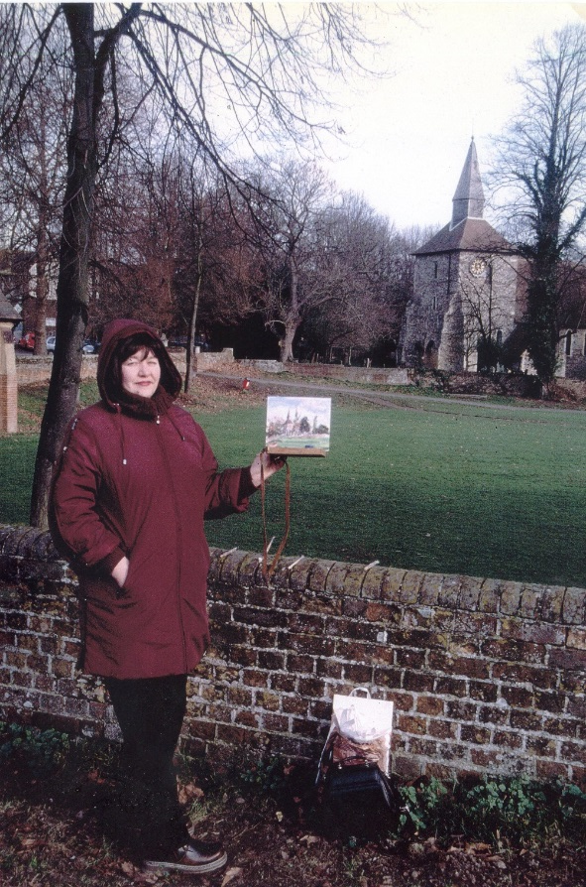
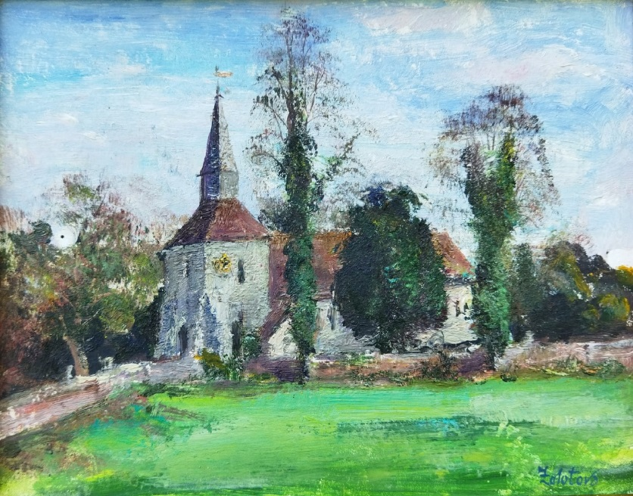
In the morning, Peggy Hayes, the woman who provided us with shelter In Canterbury, took a short tour of the very ancient and very beautiful St. Stephen's Church, of which she is a parishioner. The building and the surrounding garden are impressive. Very simple and stylish. I'm not talking about antiquity at all. According to the information stand, one of the walls has been preserved since the 3rd century AD.
A corner of Canterbury. St. Stephen's Church" Cardboard, oil 18X23 2005

Slide 15
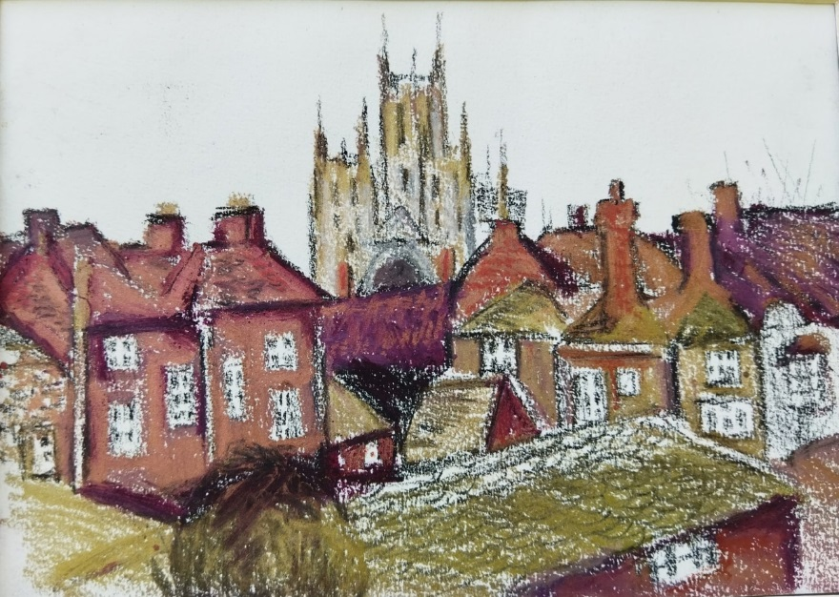
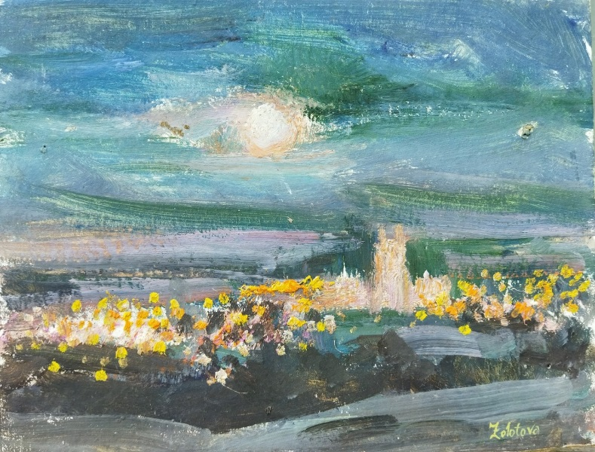
The host party has a clear schedule, which we adhere to strictly. Breakfast, work at the exhibition, lunch, free time devoted to walks and sketches, work at the exhibition again. There are a lot of visitors, they are very friendly and sociable, so time flies by unnoticed.
"Canterbury" paper, sangina 15X21 2005
"Night Canterbury" cardboard, oil 18X23 2005

Slide 16
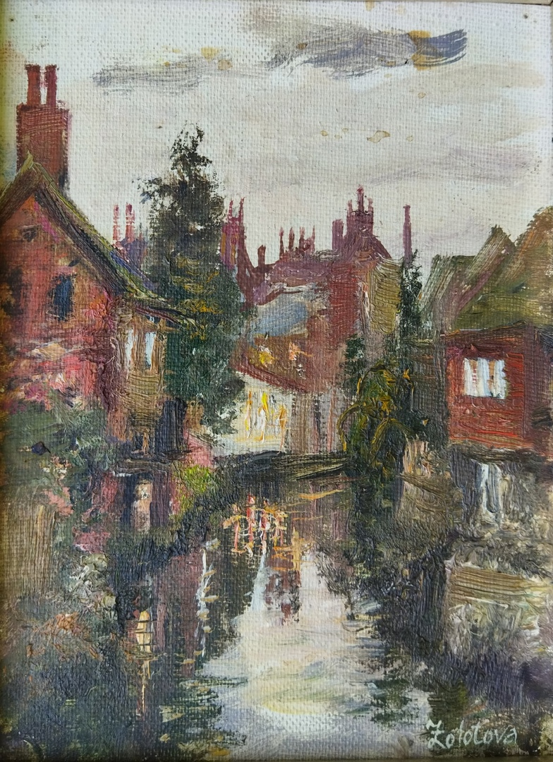
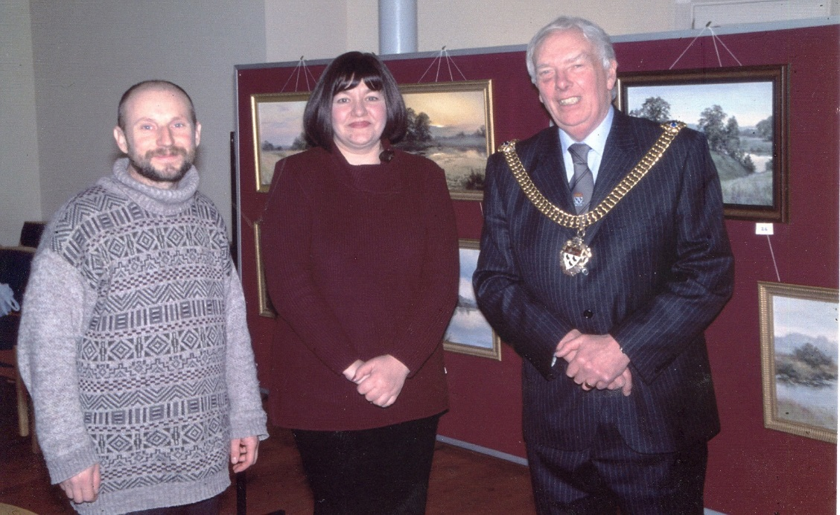
January 22 is a social day. We attended a charity dinner at St. Stephen's Church, where we were greeted with a standing ovation. It turns out that many have already seen the paintings and imbued with the Russian spirit. We did not stay at the event for long, as we were expected to meet with the Lord Mayor of Canterbury.
"Fabulous Canterbury" canvas, cardboard, oil 15X19 2005
The Lord Mayor of Canterbury at the exhibition.

Slide 17
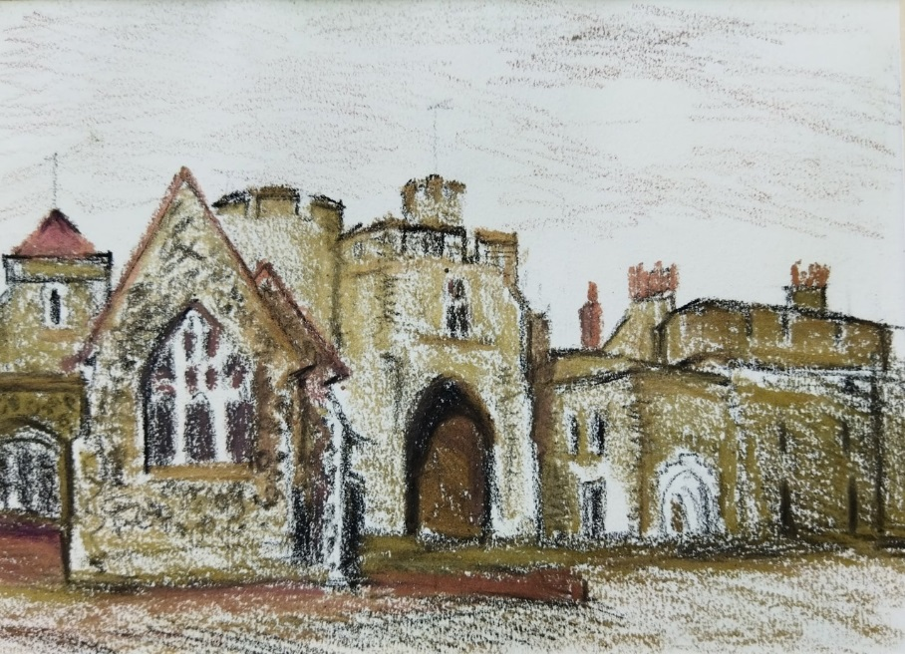
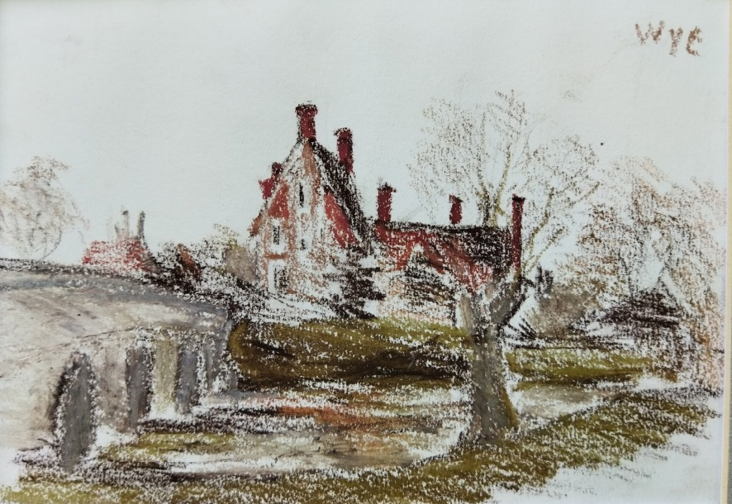
January 23rd is a day to move from Canterbury to the small university town of Wye, located 19 km from our former place of residence. Here we will be staying with a local professor and admirer of Dostoevsky's work named Harry. With the help of one of his students, our former compatriot, he outlined our immediate prospects, the most urgent of which was the installation of an exhibition in the city hall. We managed, despite some difficulties of a purely technical nature.
The City Gate to Canterbury" paper, sangina 15X21 2005
"The town of Wye" paper, sangina 15X21 2005

Slide 18
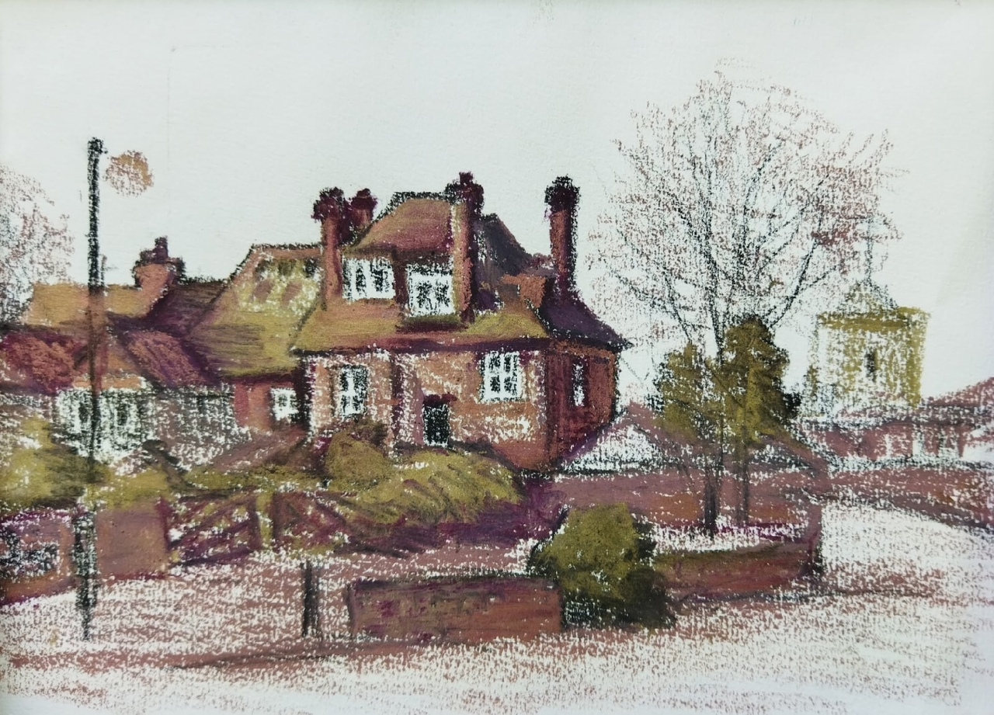
At 10 a.m. on January 24 we were at the exhibition. Full house. There are a lot of visitors for a small town. Those who want to join Russian culture, firstly, and buy paintings, secondly. Local watercolor artists also looked at the light. There's a whole community of them in the city. Noisy and enthusiastic.
An old house in the town of Wye" paper, pastel 15X21 2005

Slide 19
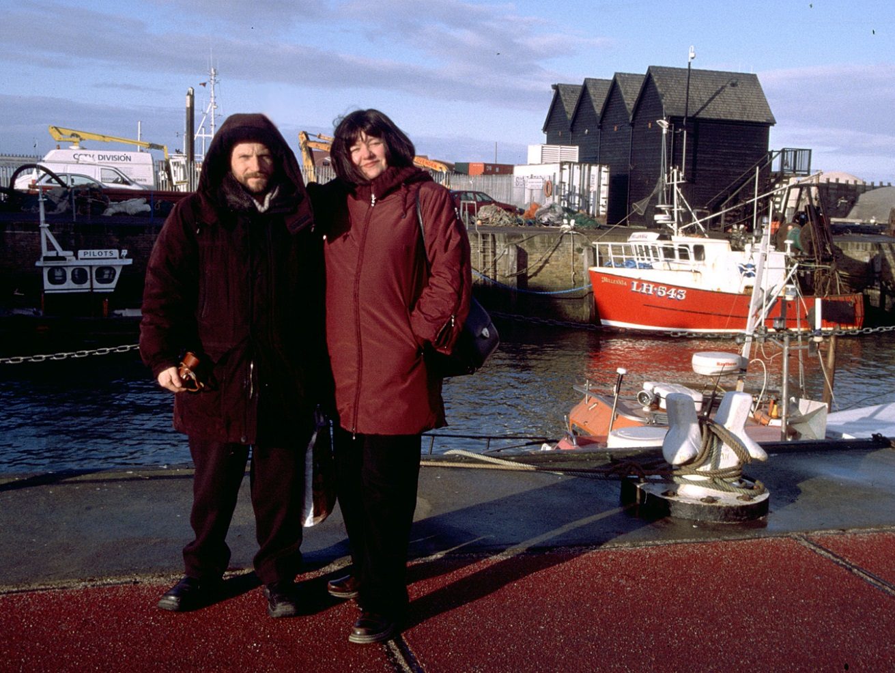
Our brief but very productive tour ended in the wonderful town of Wye. The exhibition was dismantled, loaded into John's car, and after saying goodbye to the hospitable Harry, we moved to a new point on the map. The resort town of Herne Bay. With a small and very picturesque port. Who was begging for the canvas. But not fate. A snowstorm has started. The phenomenon is so rare that old-timers do not even remember when it happened. After some time, the nature calmed down, and it turned out to make a sketch. Although not in the port.

Slide 20
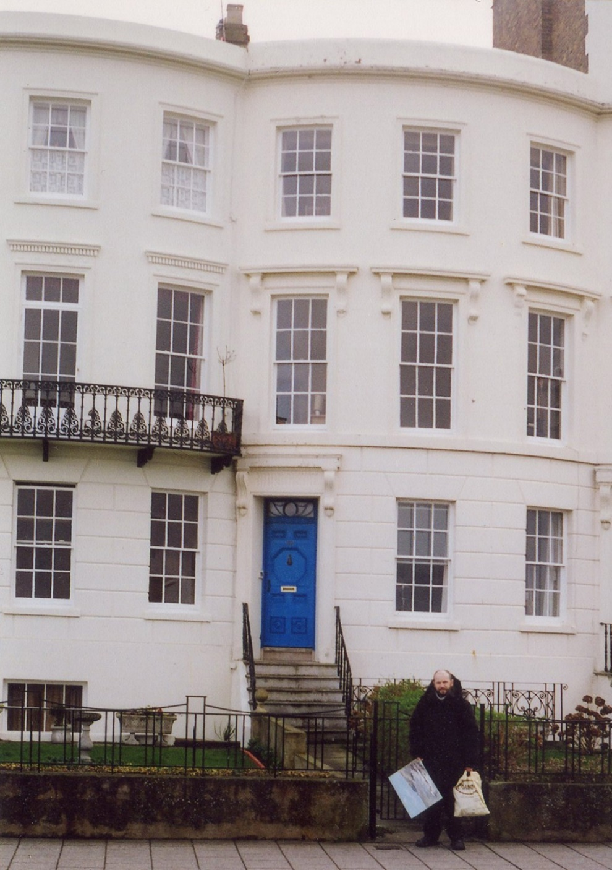
Our exhibition in Herne Bay is located in one of the houses on the waterfront, in the studio of a wonderful woman named Joan. In her three-storey outdoor studio, she lives and works doing music, textiles, painting, arranging chamber exhibitions.

Slide 21
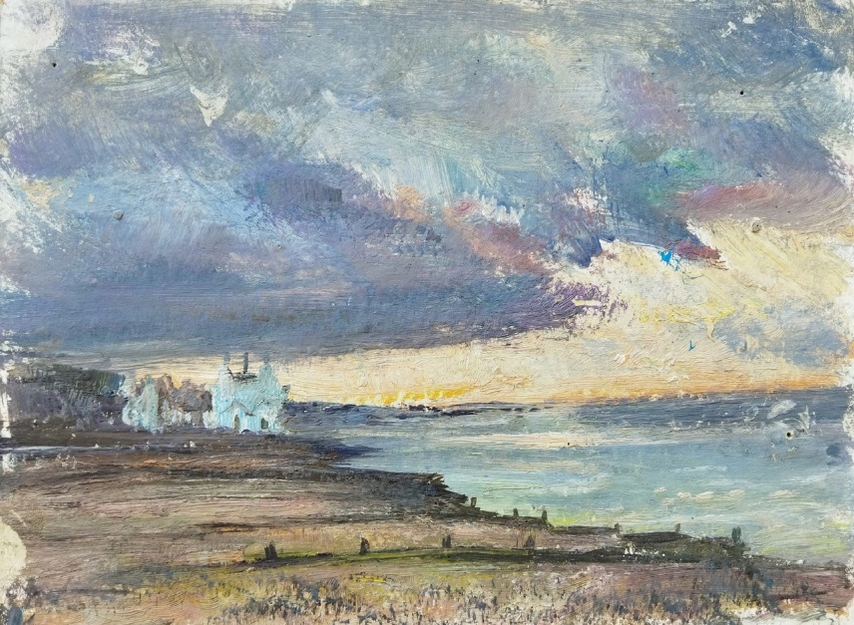
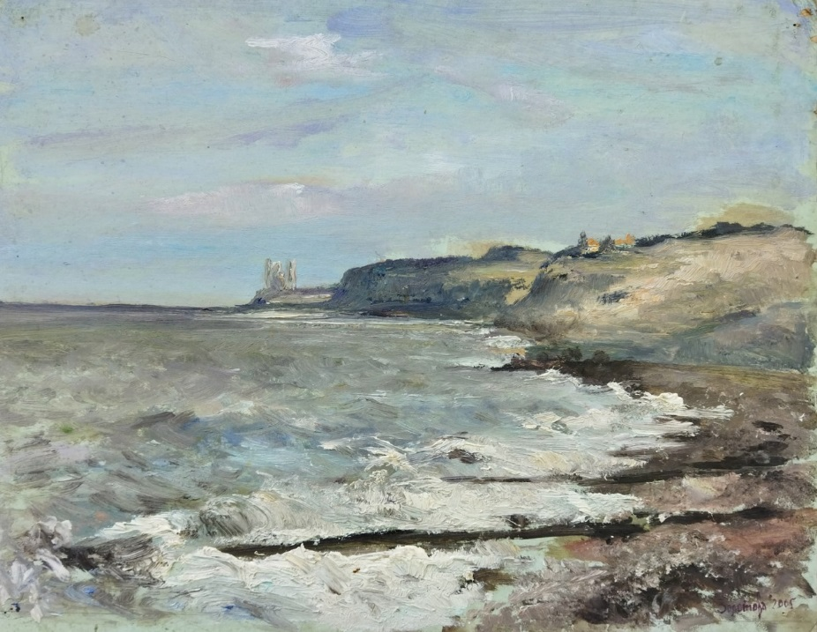
January 28. After breakfast, there was a walk along the embankment, to the chosen place for the study: the seashore, the gloomy sky, the lighthouse. England in one word. While we were walking along the embankment, local artists visited our vernissage, wanted to communicate, showed serious interest, and not only empirical, in our work. Alas! Not this time. I'm going home tomorrow, but I still need to pack the remaining paintings.
"The sky and the sea of Herne Bay" cardboard, oil 19X23 2005
“Cliffs in Herne Bay" cardboard, oil 36X46 2005

Slide 22
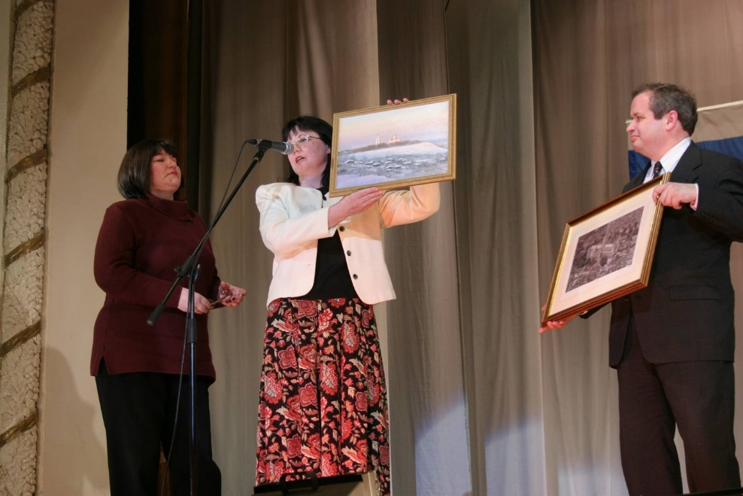
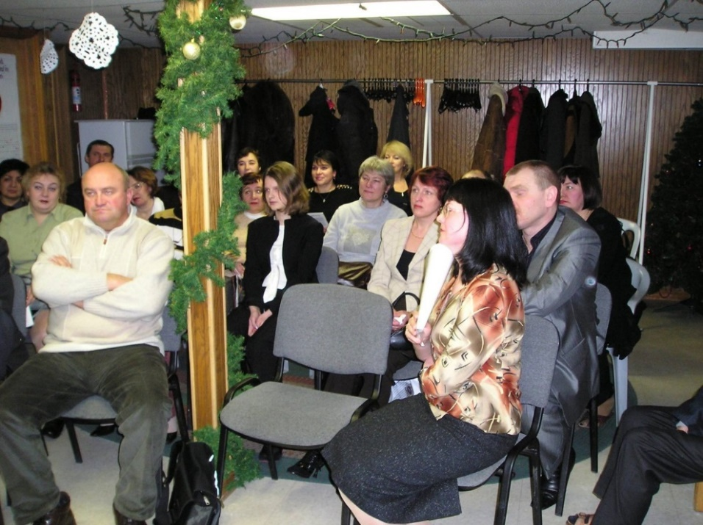
After returning from Kent, Olga Zolotova continued her cooperation with Vladimir Sister-cities Association.
In 2013, she became a member of the Union of Artists of Russia.

Slide 23
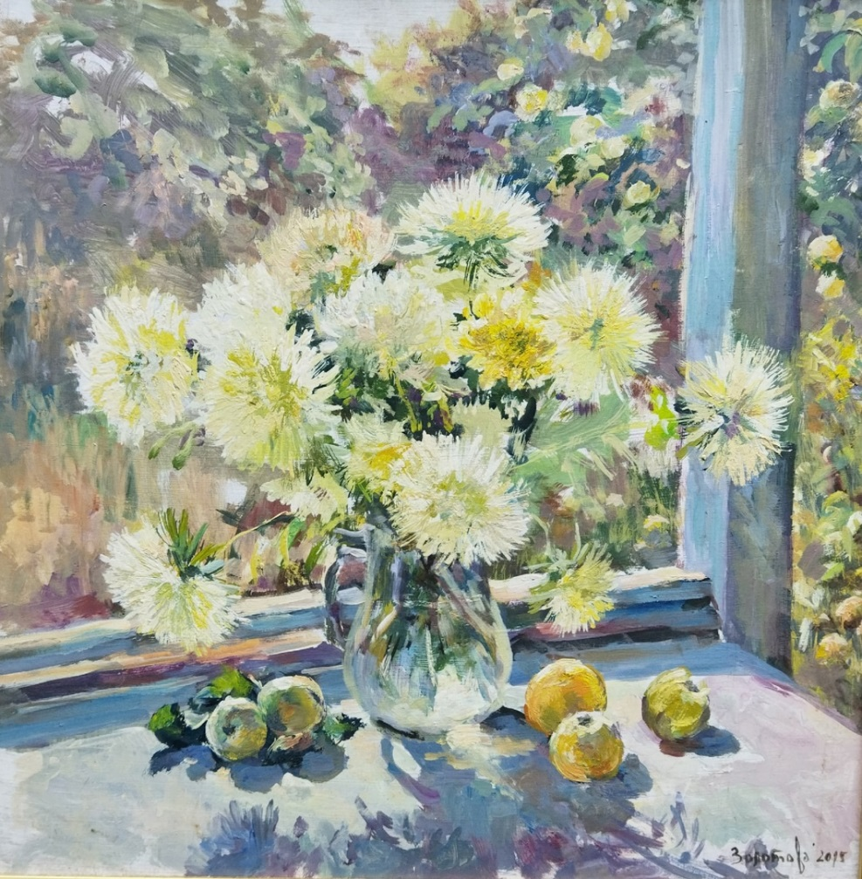
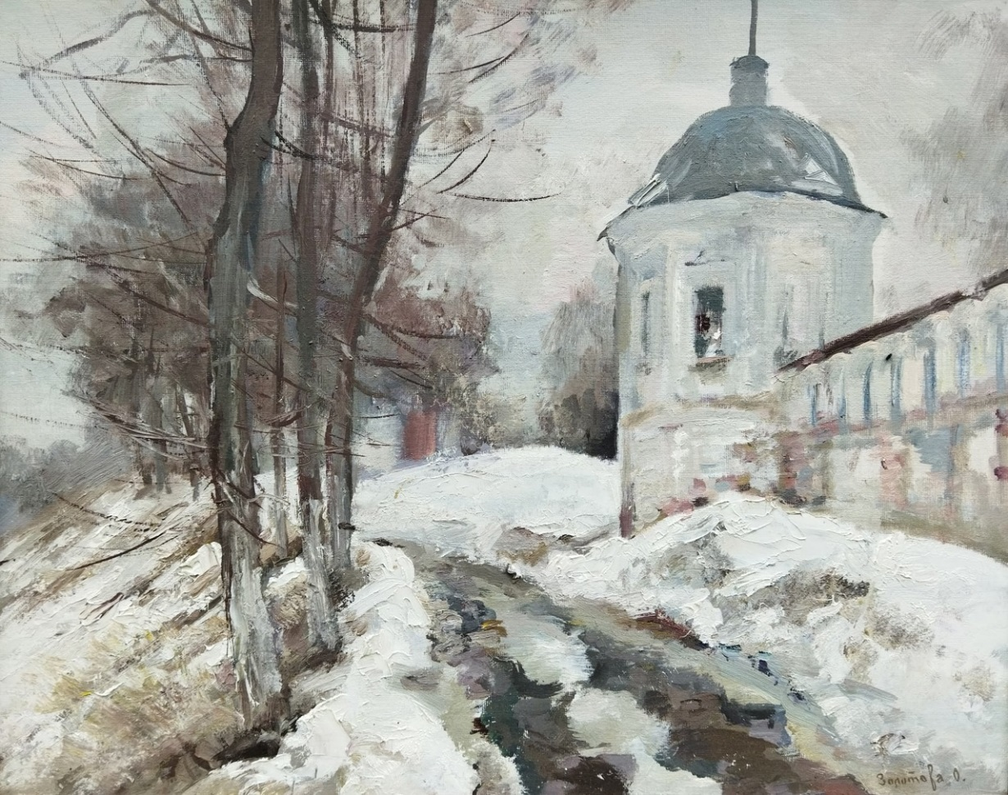
Chrysanthemums and apples" cardboard, oil 50X50 2013
"Near the monastery" canvas, cardboard, oil 40X50 2013

Slide 24
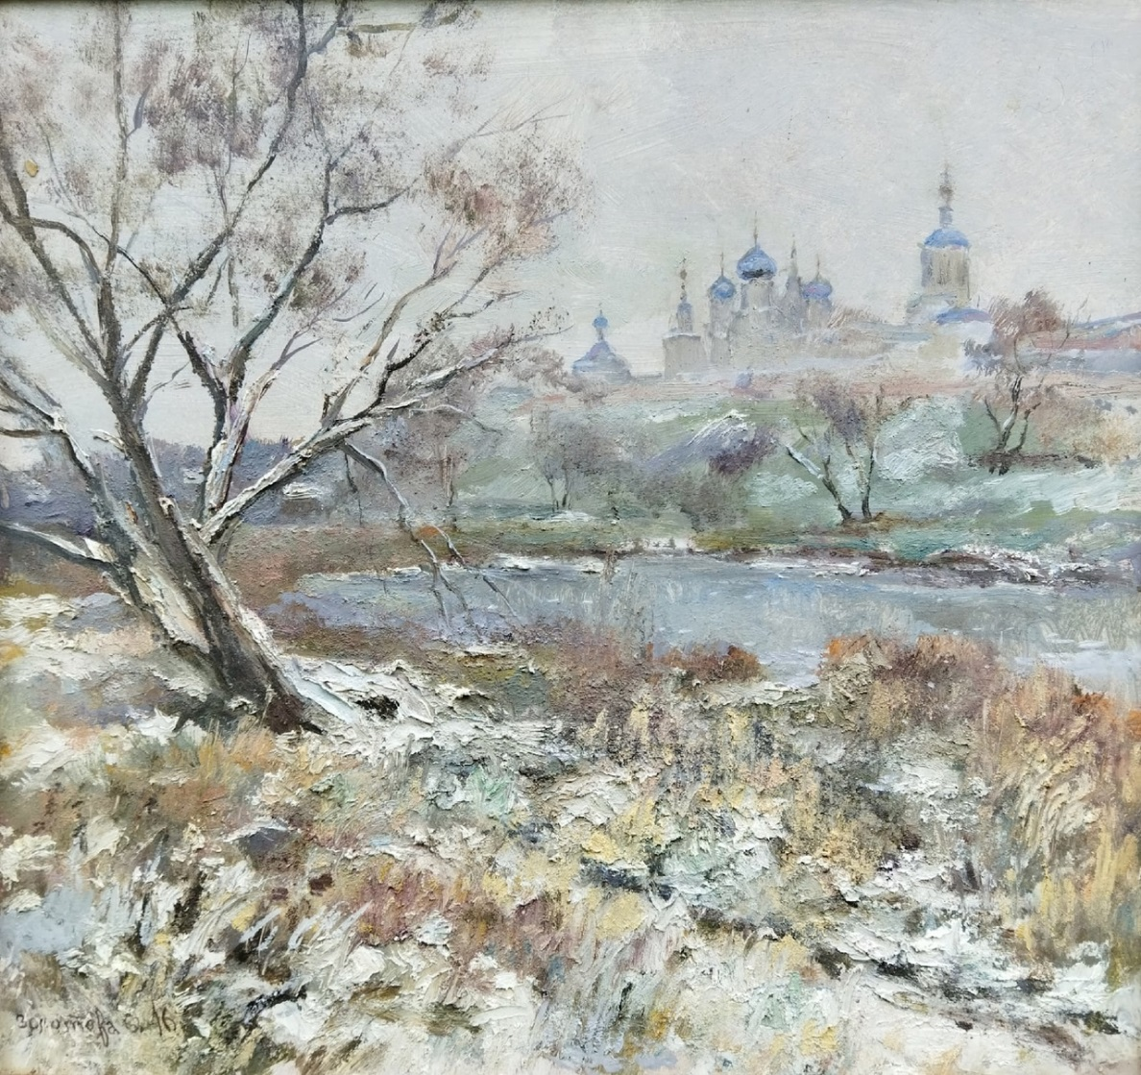
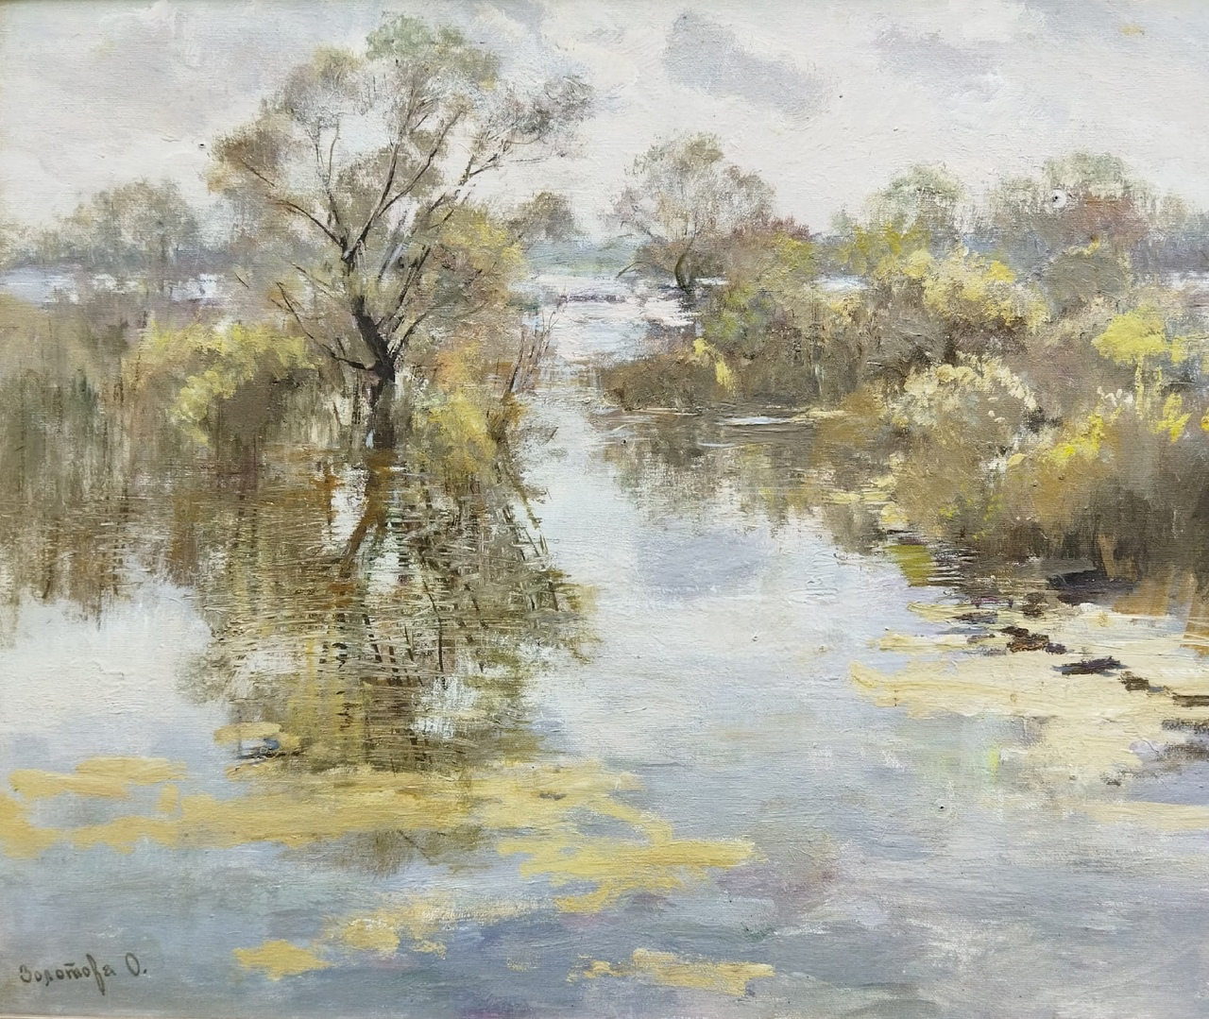
"Spring day" canvas, cardboard, oil 50x60 2016
The first snow in Bogolyubovo" cardboard, oil 50x50 2016

Slide 25
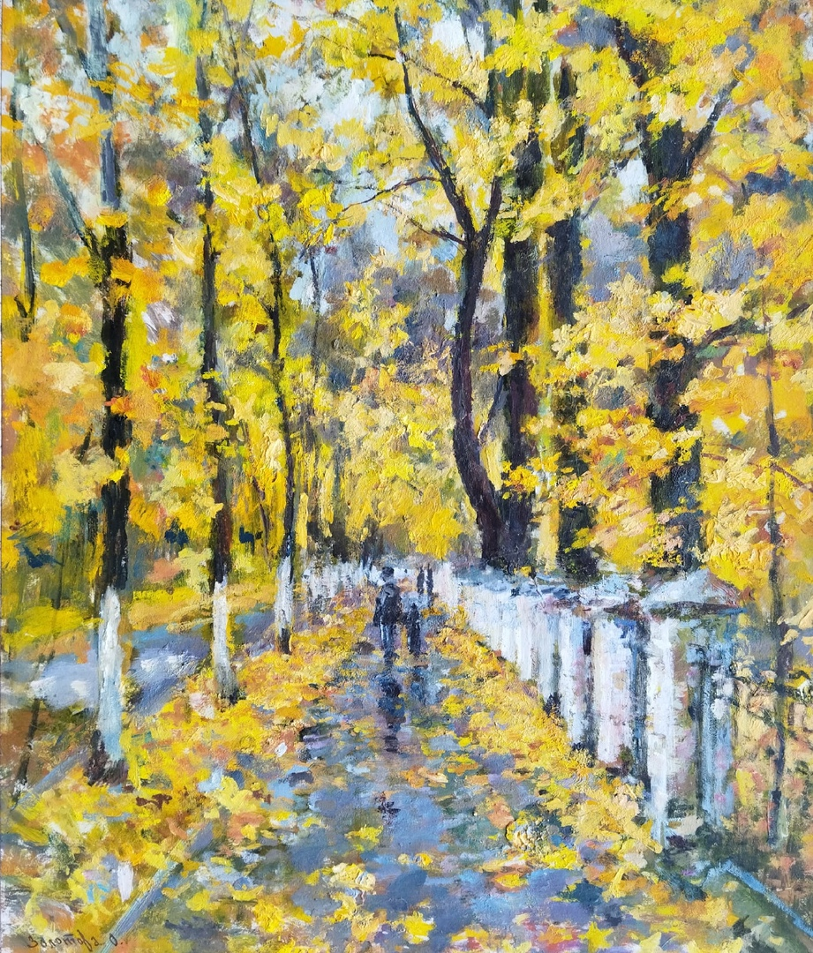
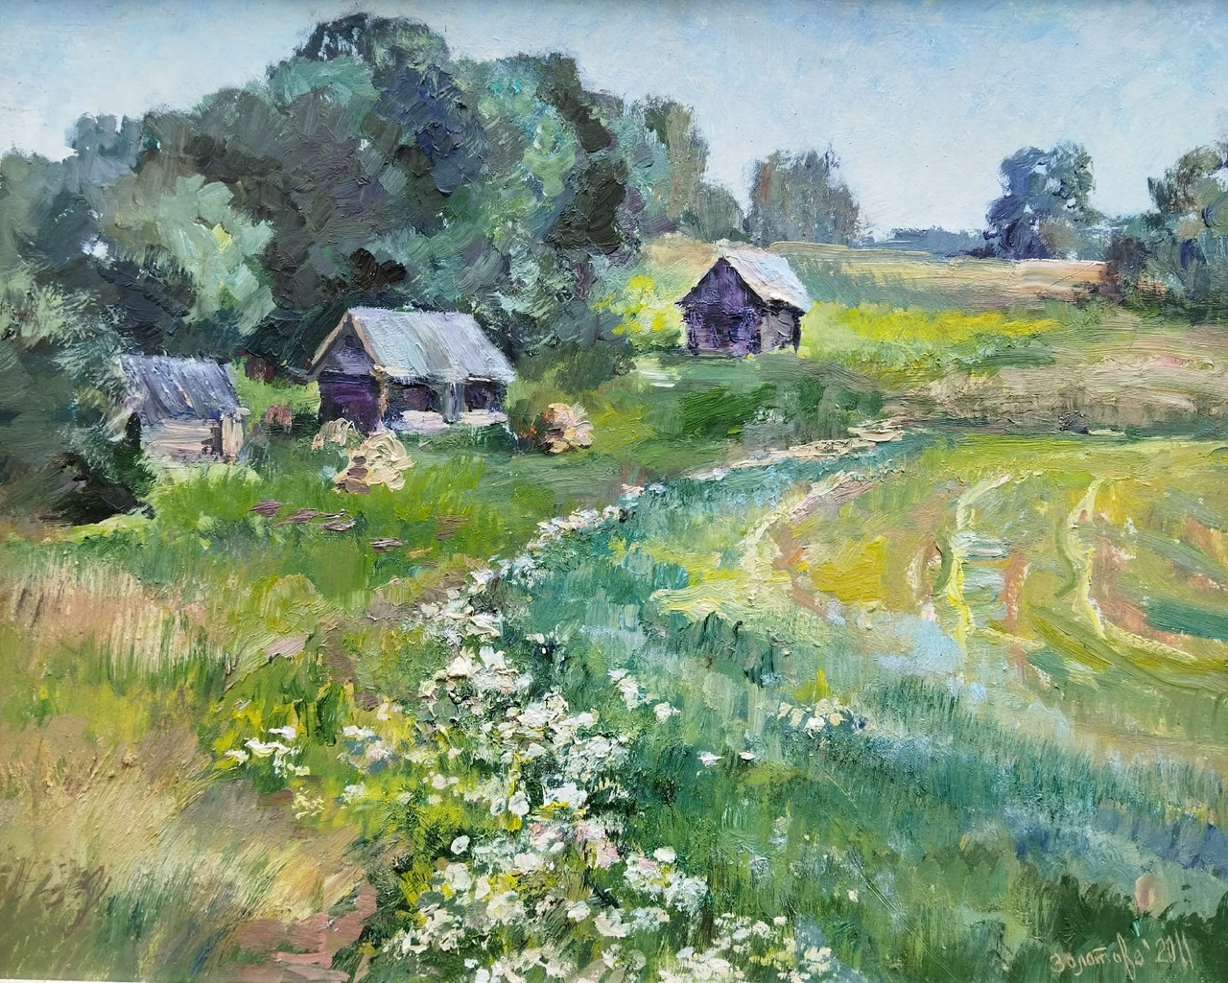
"Autumn alley" cardboard, oil 43X52 2017
"It's time for haymaking" cardboard, oil 40X50 2017

Slide 26
Thanks for your attention!

